Slide 1
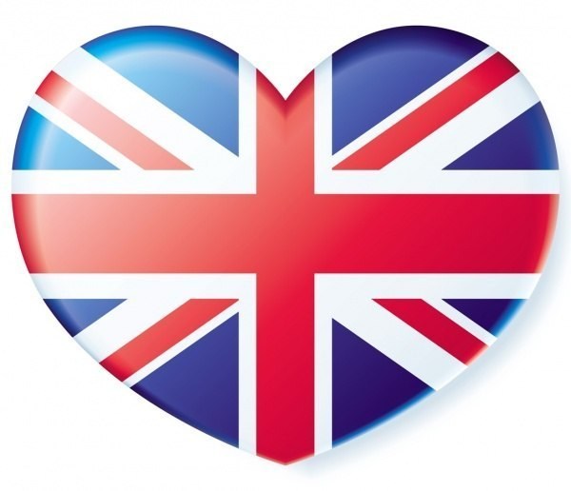
THE UNITED KINGDOM OF GREAT BRITAIN AND NORTHERN IRELAND

Slide 2
The United Kingdom of Great Britain and Northern Ireland is situated on islands. Great Britain consists of four parts. Their names are England, Scotland, Wales and Northern Ireland . Northern Ireland occupies the northern part of Ireland. It is situated on the separate island. Scotland is situated in the north of Great Britain, Wales — in the southwest, and England — in the southeast.
Great Britain is surrounded by seas on all sides and is separated from the continent by the North Sea and the English Channel.

Slide 3
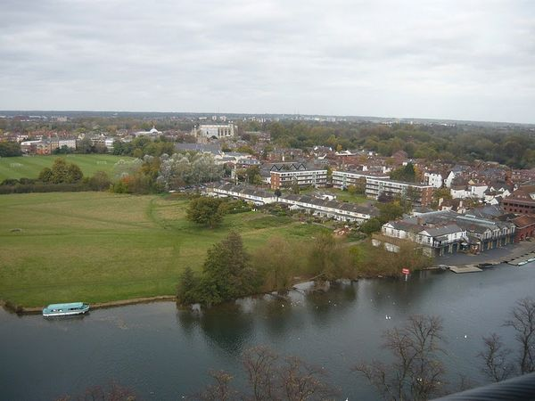
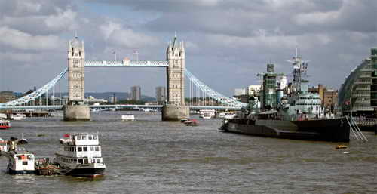
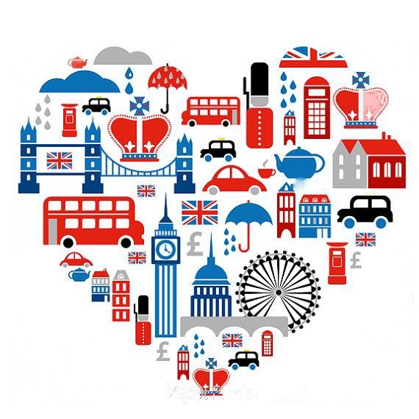
There are a lot of rivers in Great Britain, but they are not very long. The Severn is the longest river. It is 350 kilometers long. The Thames is the deepest and the most important
one.

Slide 4
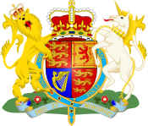
The United Kingdom of Great Britain and Northern Ireland covers an area of 244 thousand square kilometers.
The population of Great Britain is about 60 million.
The flag of Great Britain is red, white and blue.
The British people call it “the Union Jack”.
The coat of arms of Great Britain has a crown on the shield, because it’s a monarchy. The shield is supported by the English lion and by the Unicorn of Scotland.
The official language of the United
Kingdom of Great Britain and Northern
Ireland is English.

Slide 5
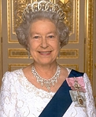
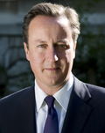
Politics of the United Kingdom
The UK is a parliamentary monarchy. The British Parliament consists of two Houses: the House of Lords and the House of Commons. The Prime Minister is the political leader of the United Kingdom and the Head of the Government.
Elizabeth II
Elizabeth II
David Cameron was appointed Prime Minister in May 2010
In Britain the Queen is the Head of state, but in fact she doesn’t rule the country as she has no power. The Queen is a symbol of the country history and its traditions.
David Cameron was appointed Prime Minister in May 2010.

Slide 6
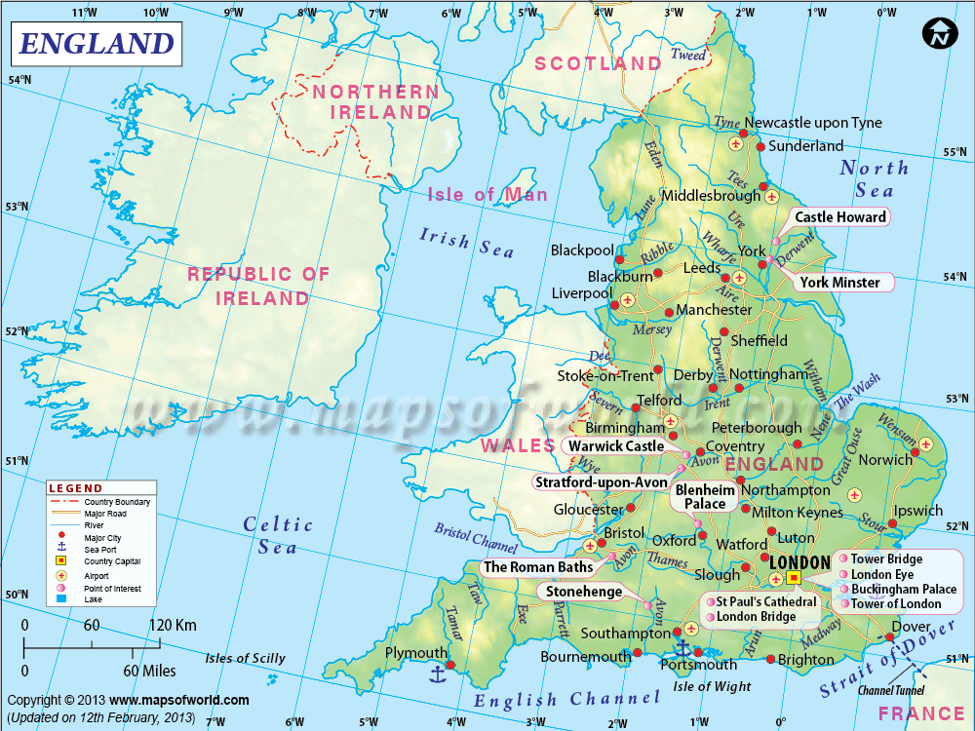
England is situated in the central and southeastern part of Great Britain. Historically it's the most important part of the country. It's also the biggest and the most populated part of the UK.

Slide 7
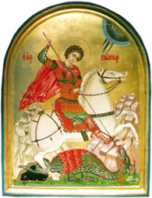
The flag of England is the red cross of St George. St George is the patron saint of England and St George’s day is celebrated on 23rd April. 23rd of April is also celebrated as the birth and death days of William Shakespeare.
Red rose is the emblem of England.

Slide 8
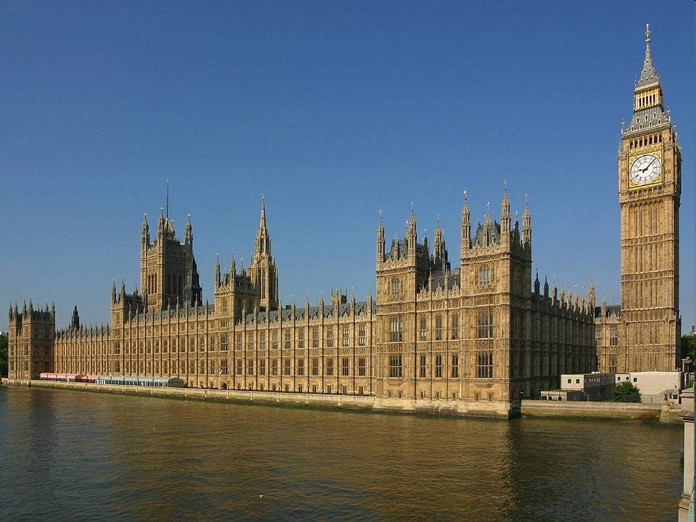
_{London is} the capital of Great Britain and England.
Its population is over 8 million people. London is the biggest industrial and cultural centre of Great Britain. London has many wonderful places of interests.
The Houses of Parliament building and Big Ben – the biggest clock bell in Britain. It weighs is 13,5 tons.

Slide 9
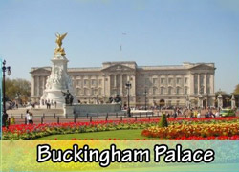
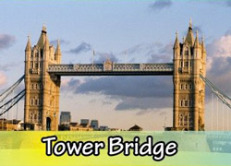
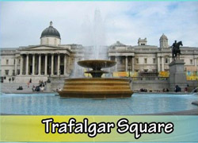
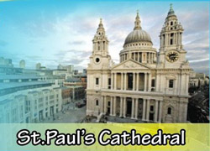
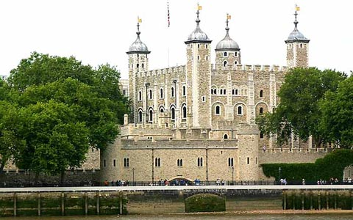
.
London’s places of interests

Slide 10
The GlobeTheatre is a theatre in London associated with William Shakespeare.

Slide 11
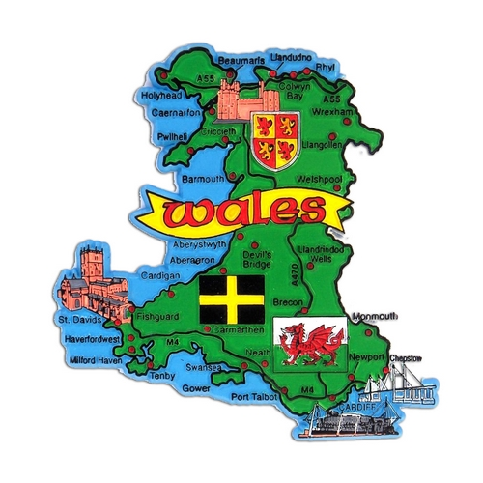
Wales is the Land of Songs
Wales is one of the most beautiful countries in the United Kingdom

Slide 12
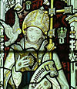
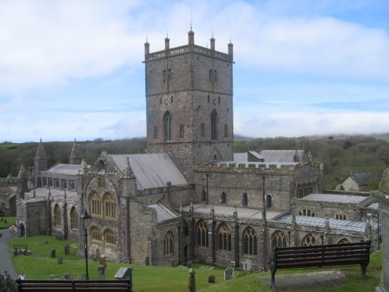
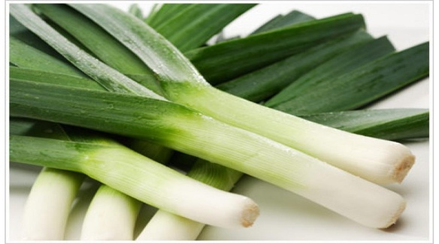
Wales is a country situated in the West of Britain.
The population of Wales is about three million. The area of Wales is 20,764 sq. km.
St. David is the patron saint of Wales. St. David’s Day is celebrated on 1st March.
A leek or a daffodil are the symbols of Wales.
St. David's Cathedral
St. David's Cathedral

Slide 13
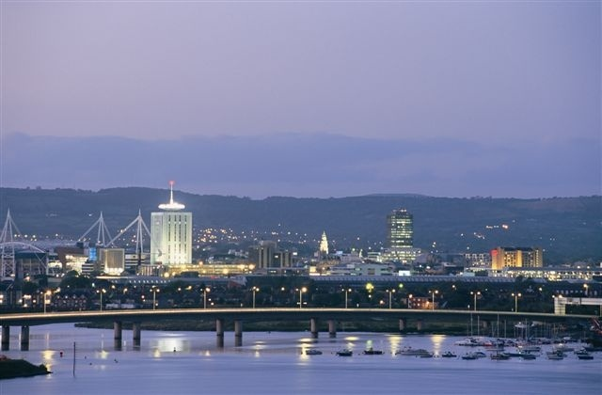
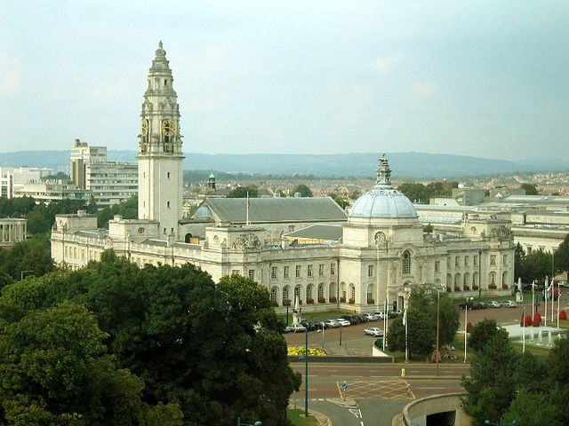
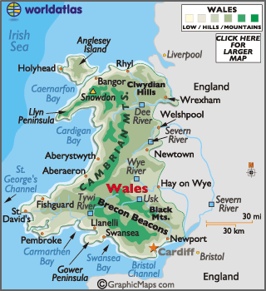
The capital of Wales is Cardiff.
Cardiff is the capital of Wales, an industrial city and its main port. Cardiff City Hall

Slide 14
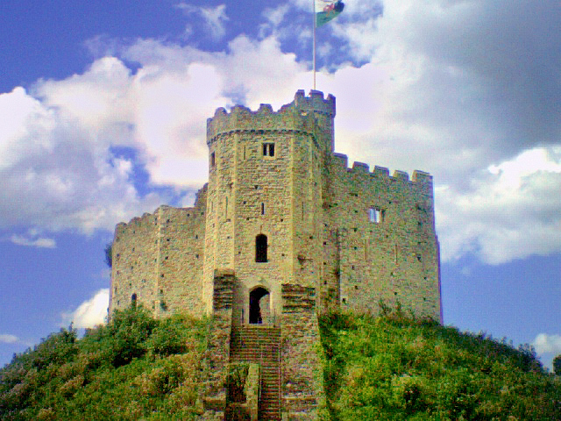
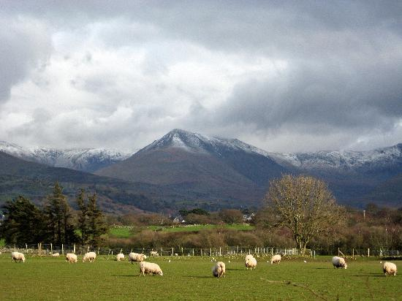
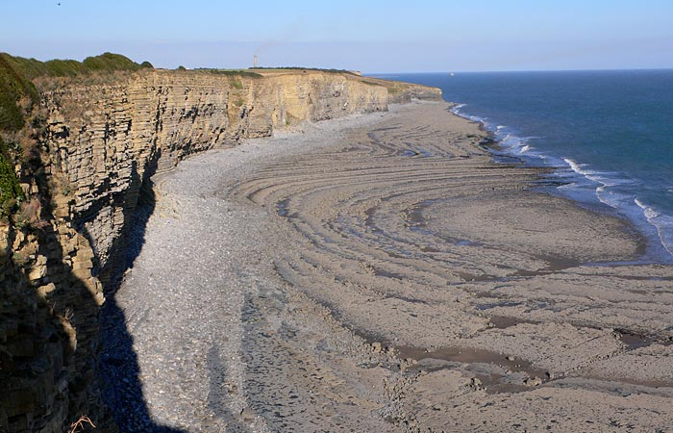
Wales is full of little towns, castles and seaside villages
Castle Cardiff
Castle Caernarfon
Beautiful Snowdon

Slide 15
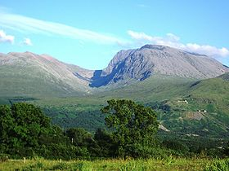
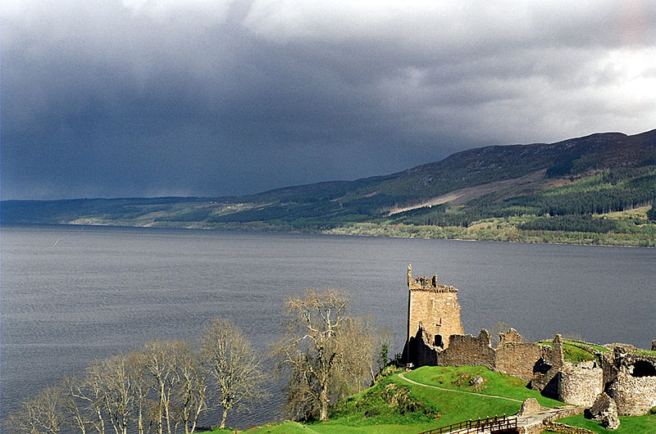
Welcome to Scotland
Scotland is the north part of Great Britain. 5 million people live in Scotland. Its area is 78,789 sq km. The population of Scotland is 4,996,000.
It is divided into three regions: Lowlands, Highlands and Southern Upland. Scotland is full of mountains and lakes. The highest mountain is Ben Nevis. Loch Lomond and Loch Ness are the biggest lakes.

Slide 16
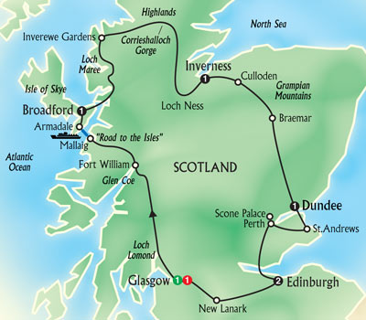
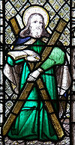
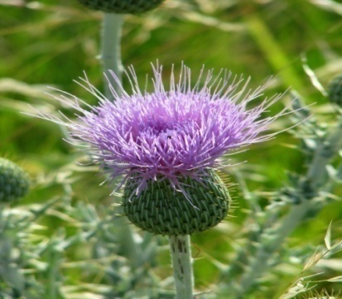
The Scottish flag is a white cross on a blue background.
St. Andrew is the patron saint of Scotland.
St. Andrew’s Day is celebrated on 30th November.
The thistle is the symbol of Scotland.

Slide 17
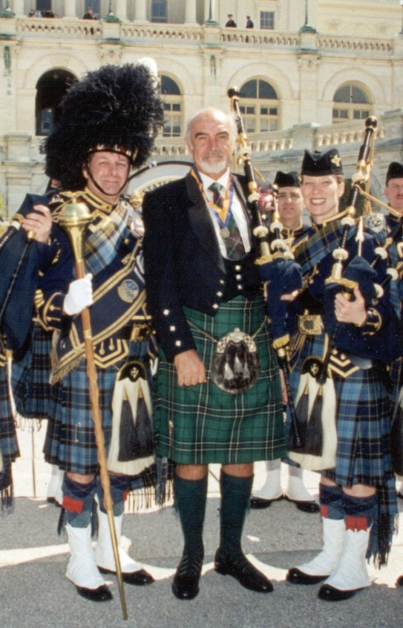
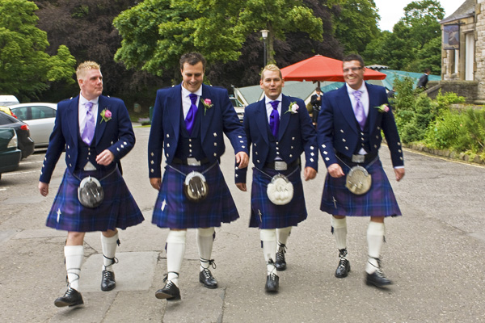
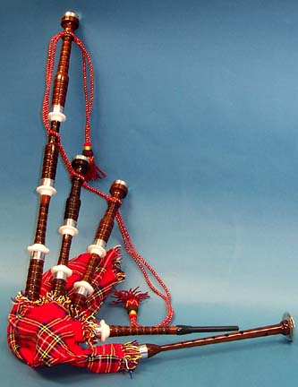
Scotland is famous for:
Kilts - traditional Scottish woolen cloth costume with a tartan or plaid pattern. This is a skirt that men wear.
Bagpipers - people who play the bagpipes, a traditional Scottish instrument .

Slide 18
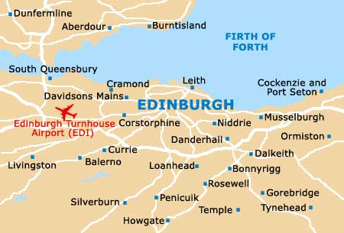
Edinburgh,capital of Scotland, is one of Britain's most attractive and oldest cities. It has a lot of interesting places to see. At the top of the highest hill in Edinburgh is Edinburgh Castle, the main place of interest in the city. It is very famous.

Slide 19
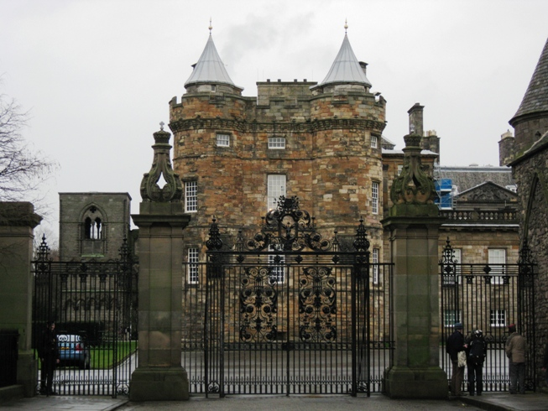
Holyroodhouse Palace is the place where the Queen lives when she comes to Scotland. The palace is closed when the Queen is in Edinburgh.

Slide 20
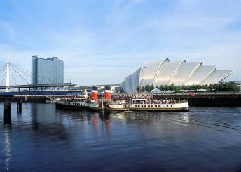
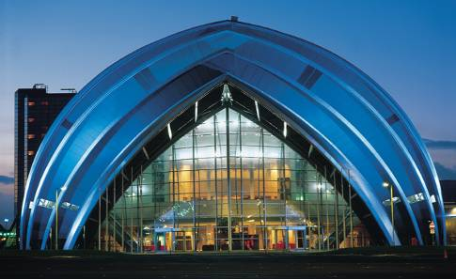
Glasgow is the largest city in Scotland and the third largest
in the United Kingdom.

Slide 21
The counties of Northern Ireland - the smallest part of the UK
Northern Ireland is a part of the United Kingdom. It is made up of six parts: Antrim, Armagh, Down, Fermanagh, Londonderry, Tyrone.
The total area is 13,843 km ².
The highest point is the draining of the country Donard in the Mourne Mountains. Its height is 848 metres.
In the central part of the country is a lake Lough Neagh (392 km ²).
The main rivers of the country are Foyle, Bann .

Slide 22
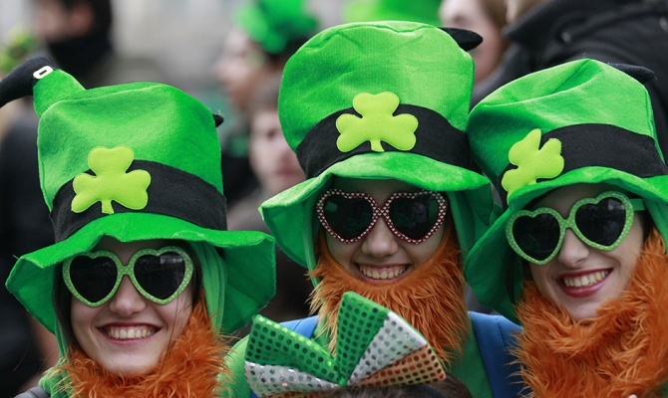
National symbols
St. Patrick
March 17th
The population of Northern Ireland is more than a half million people.
State languages in Northern Ireland are English, Irish and Gaelic.
St. Patrick
Shamrock

Slide 23
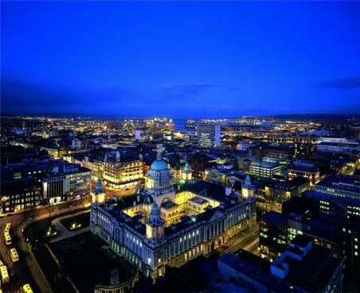
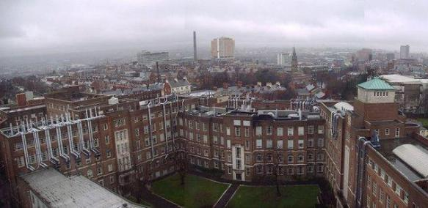
The capital of Northern Ireland is Belfast. Belfast is a lively, cultural center, where there are excellent museums and galleries, as indeed, in many cities in the UK, as well as pubs, bars, theaters, parks, restaurants and other entertainment.

Slide 24
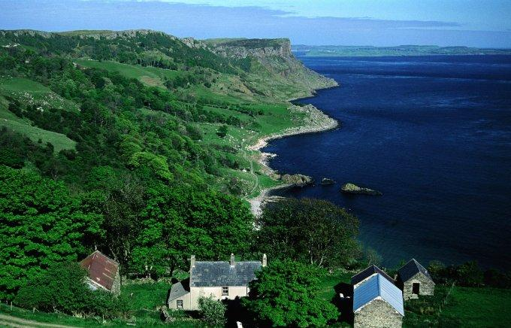
The Emerald Eye
"Road of Giants" is rock formation on the northern coast, consisting of several thousand multi-faceted basalt columns up to 6 metres in height.
The famous Antrim Coast

Slide 25
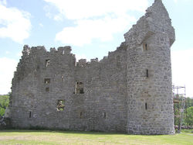
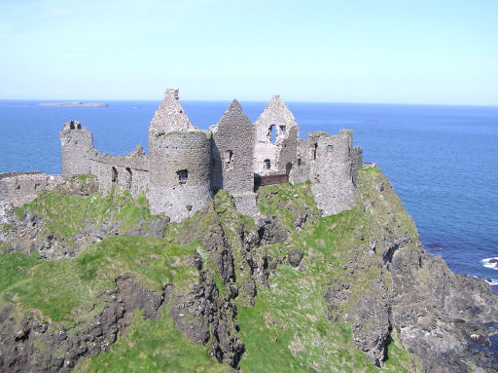
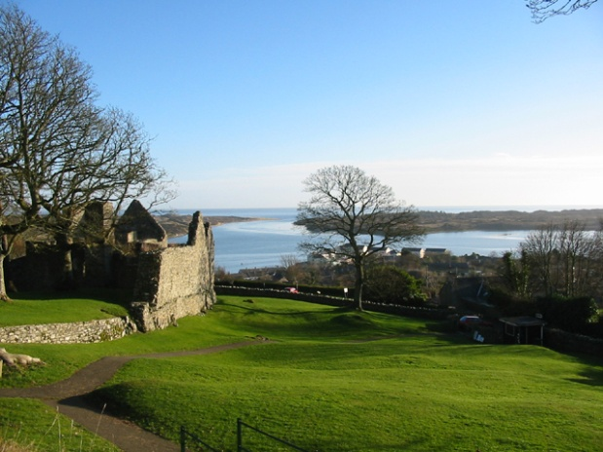
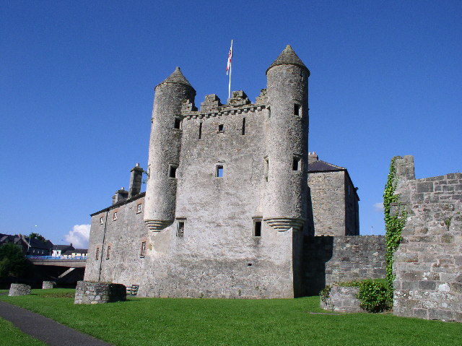
Northern Ireland has some of the finest castles on the island.
The Monea Castle
The Dunluce Castle
The Carrickfergus Castle
The Dundrum Castle
The Enniskillen Castle

Slide 26
Welcome to Great Britain!

