Slide 1
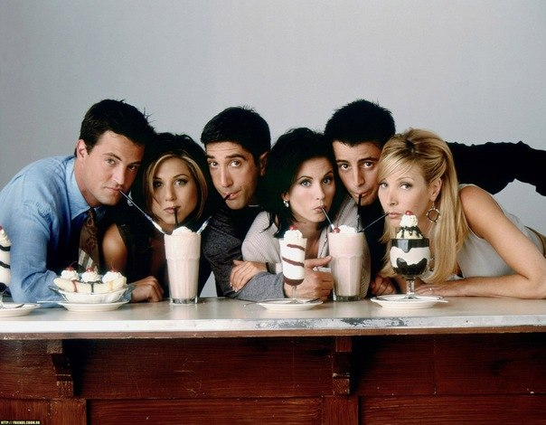
Friends

Slide 2
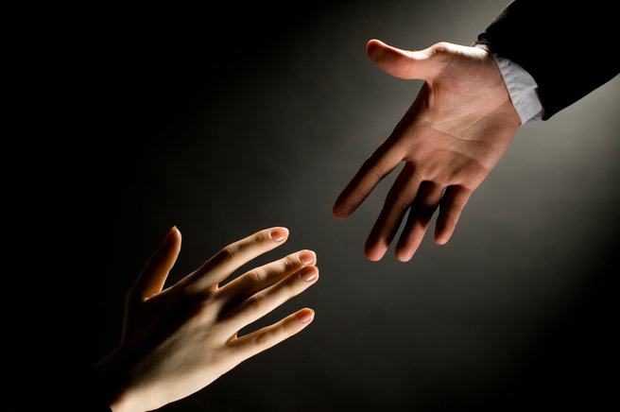
Friend - is the man who will lift you when others do not even guess that you fall!

Slide 3
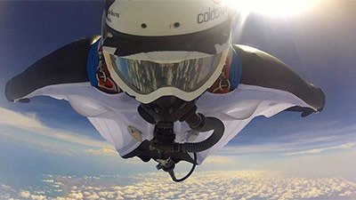
Friends - these are the people who catch you at the bottom, when you're falling.

Slide 4
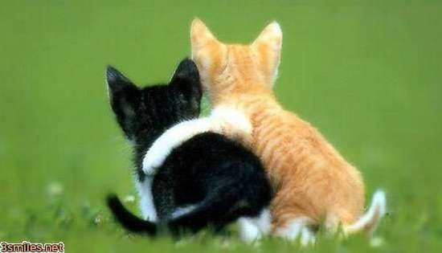
A faithful friend to dare to tell you things that you do not dare to admit to himself.

Slide 5
Best friends are always with you in difficult times, even if you refuse to talk to them. They just know that loneliness and silence will kill you.

Slide 6
Like good health, true friendship is valued as long as lost.

Slide 7
Best friend knows everything about you, and even more, but he does not despise, but still continues to love and respect you.

Slide 8
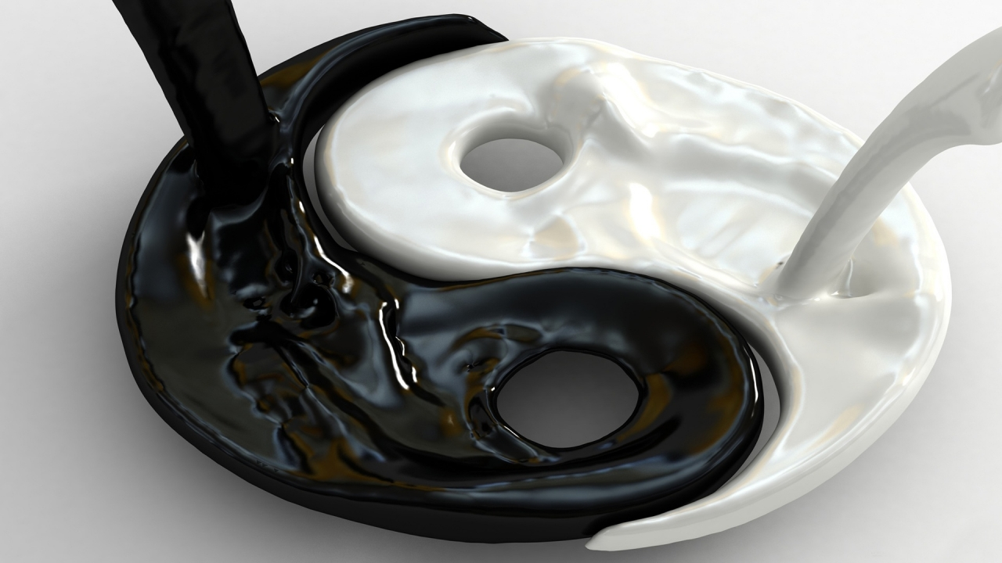
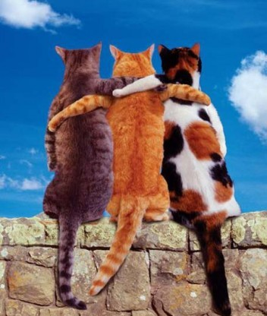
Everyone is a friend, until he proves otherwise

Slide 9
I have a lot of friends ... but the best friend is a mom and a tittle.

Slide 10
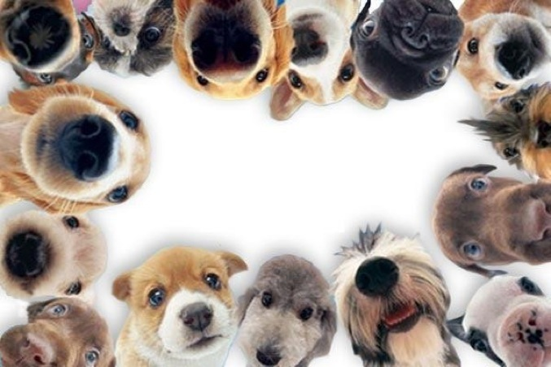
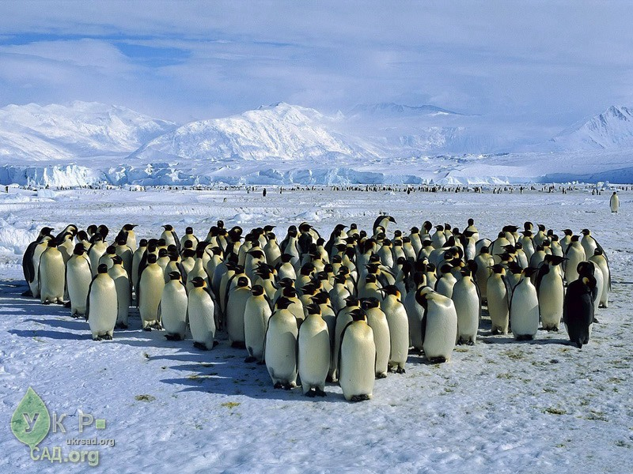
And this too
This is my classmates, who are looking into the computer

Slide 11
Presentation prepared
Novak Sergio ;)

