Slide 1
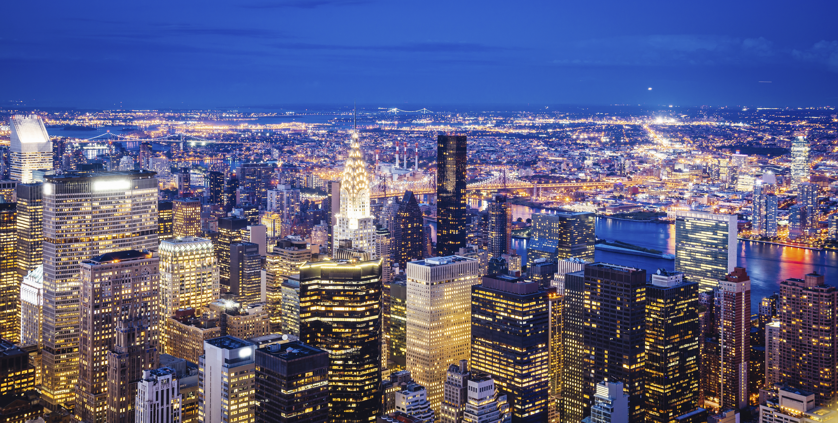
The USA

Slide 2
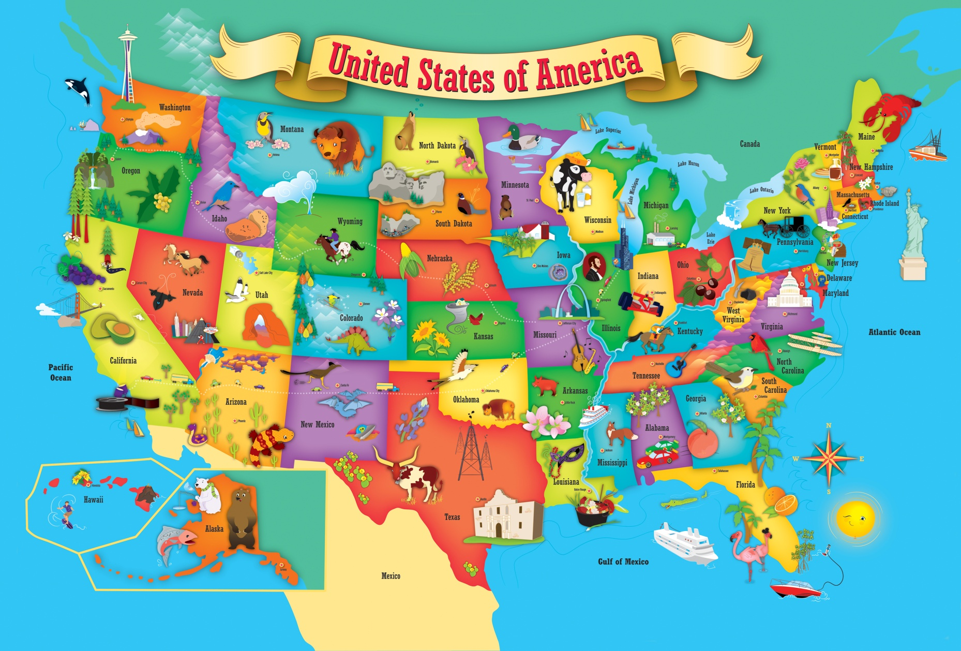
The USA consists of three separate parts. They are the Hawaiian Islands, Alaska and the rest major part of the USA.

Slide 3
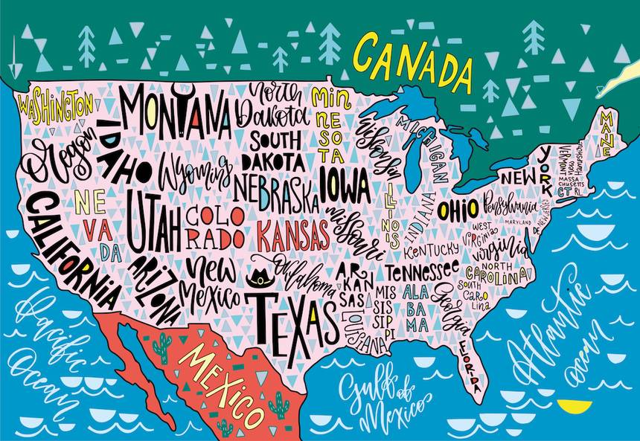
There are fifty states and district of Columbia. The states differ very much in size, population and economical development. The population of the United States is about 330 million people.

Slide 4
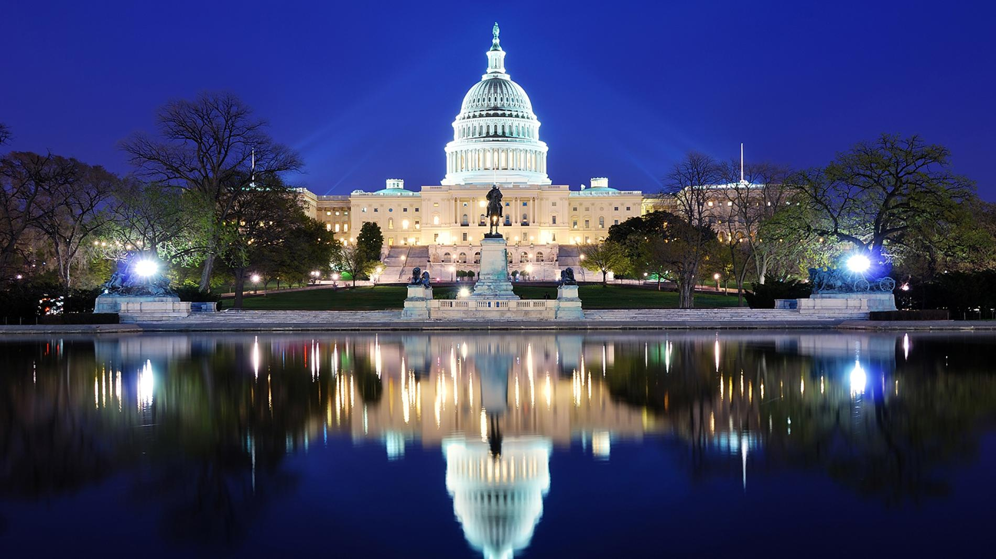
The capital of the United States is Washington. It was named in honor of the first president whose name was George Washington.

Slide 5
The biggest cities of the USA are New York, San Francisco, Los Angeles, Chicago

Slide 6
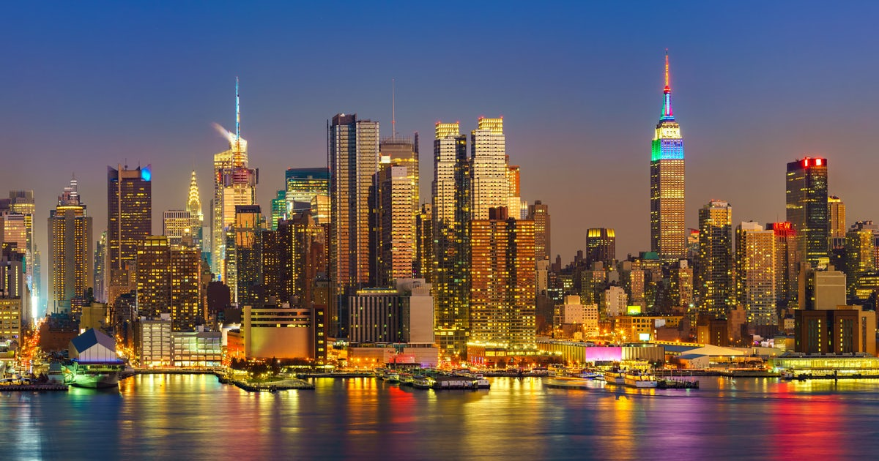
New York

Slide 7
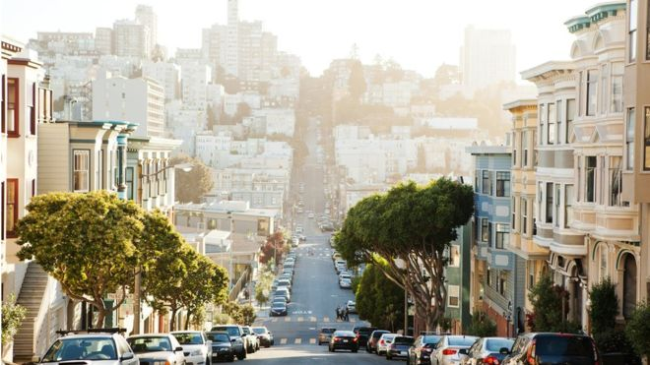
San Francisco

Slide 8
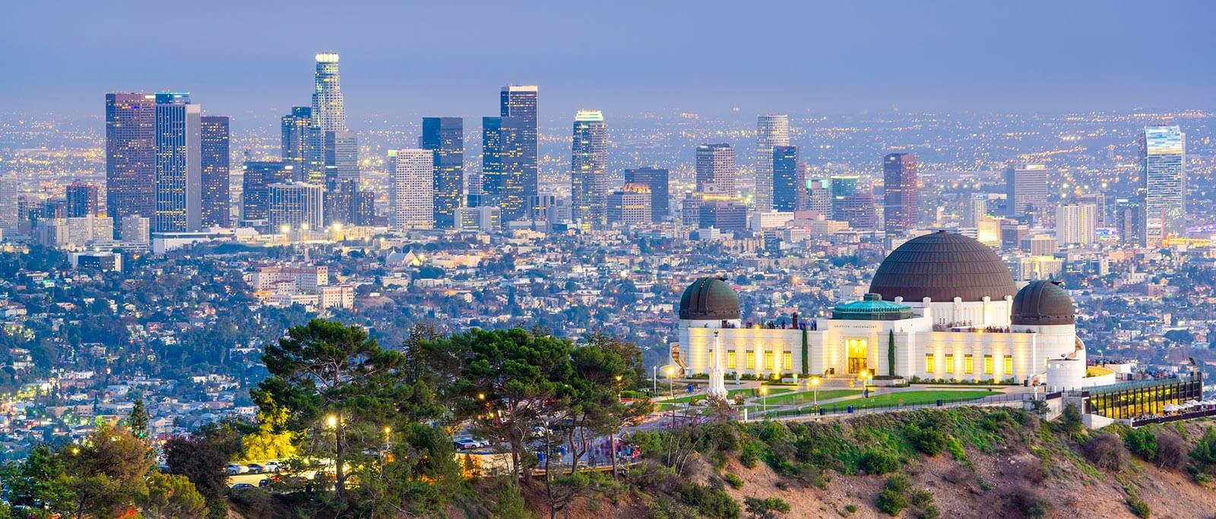
Los Angeles

Slide 9
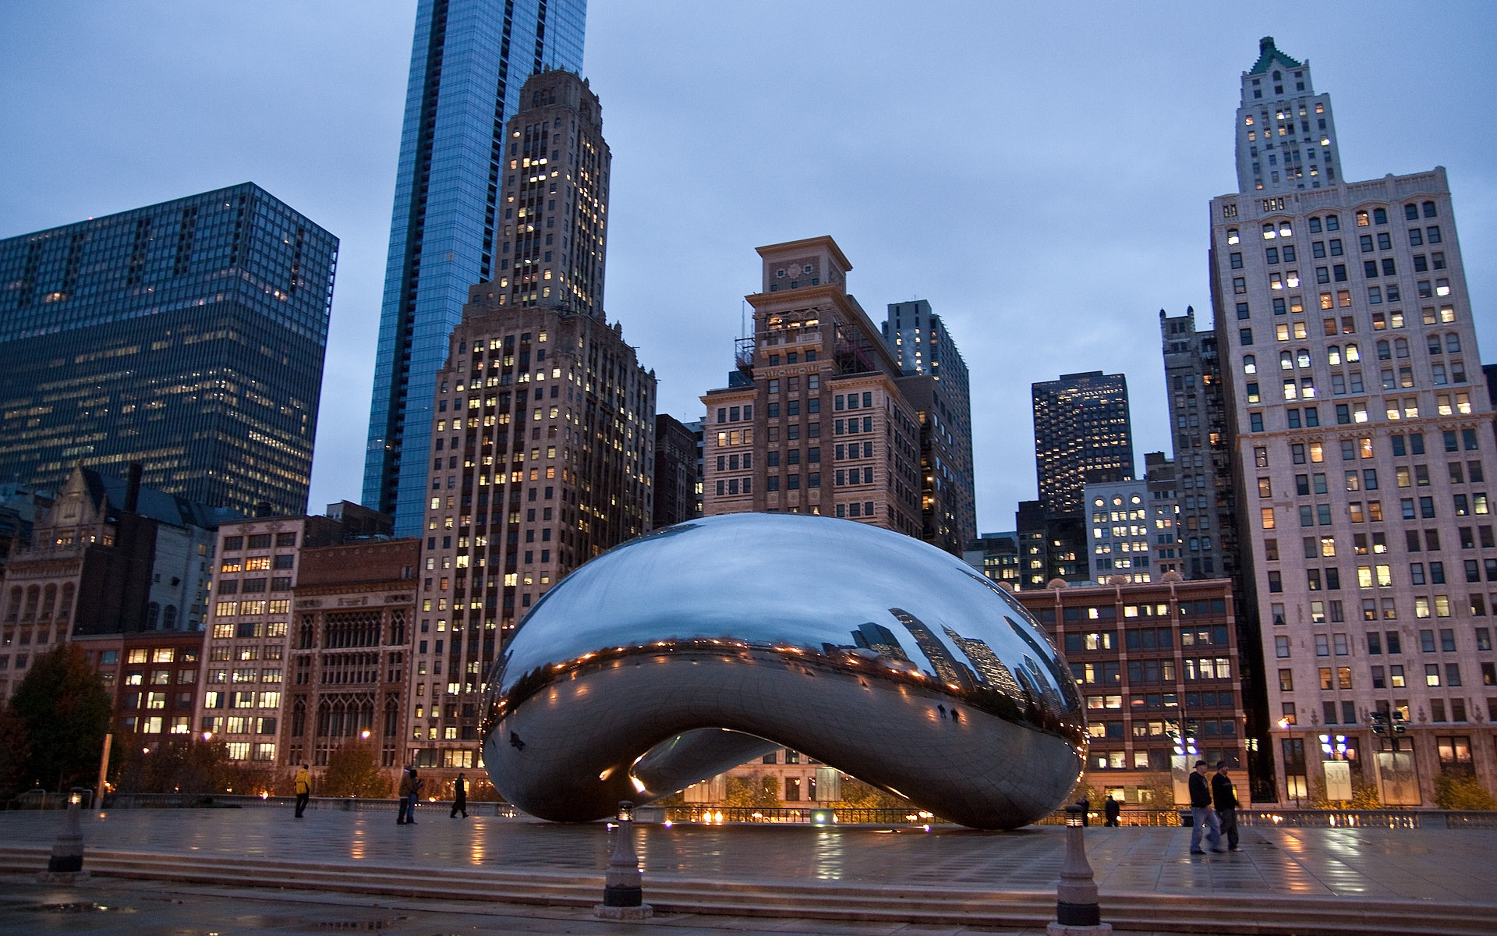
Chicago

Slide 10
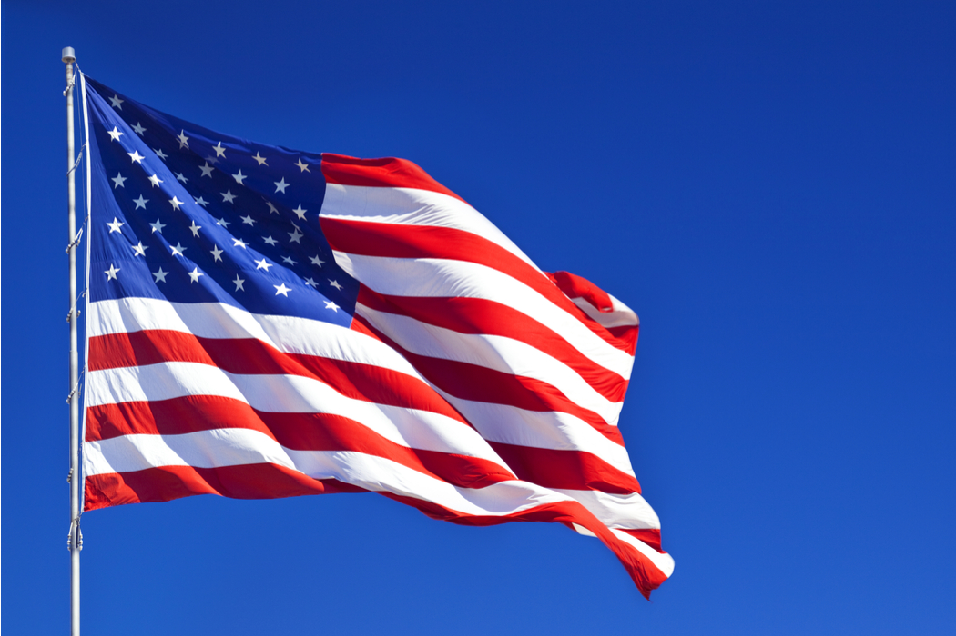
The American flag is often called «The Stars and Stripes» (other names «Old Glory» and «The Star-Spangled Banner»). It has 13 horizontal stripes,7 red and 6 white which stand for the original 13 states

Slide 11
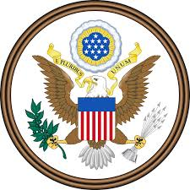
The Great seal is used as the national coat of arms of the United States. It is officially used on documents such as United States passports

Slide 12
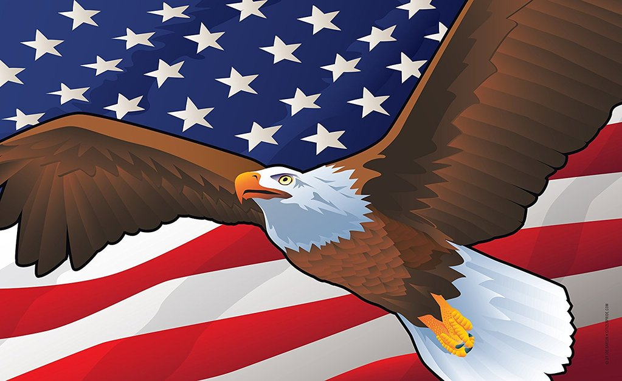
The Bald Eagle is the national bird of the USA and is represented on its Seal. Bald Eagles are not actually bald, the name derives from an older meaning of «white headed».

Slide 13
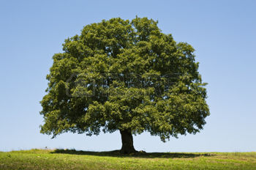
Oak Tree is the National Tree of United States of America. Oak Tree was adopted as the National Tree of United States in November 2004.

Slide 14
Tourist attractions

Slide 15
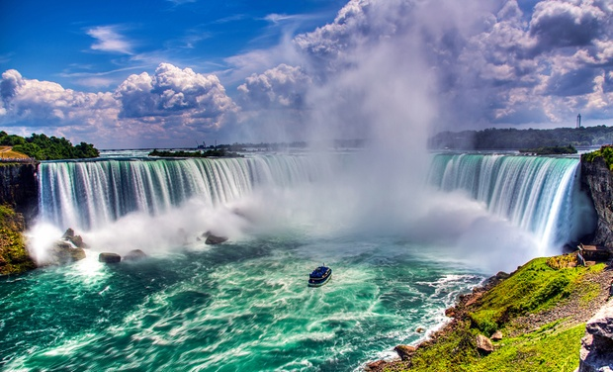
Niagara Falls

Slide 16
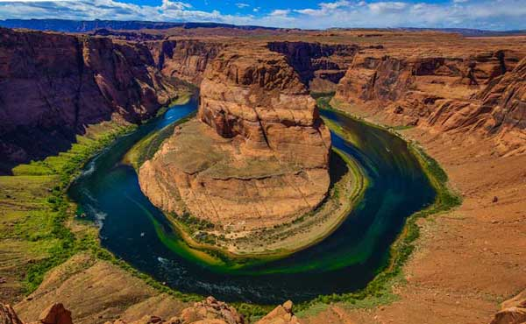
Grand Canyon

Slide 17
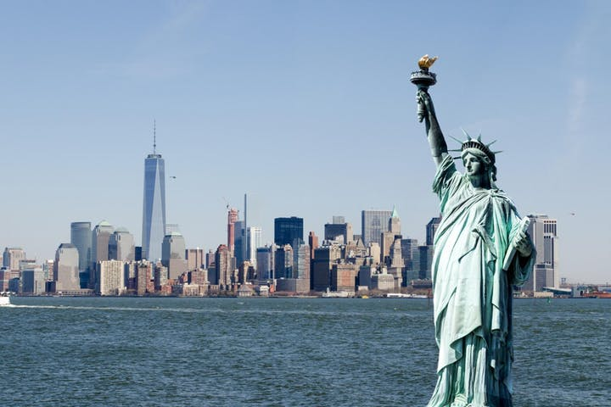
The Statue of Liberty

Slide 18
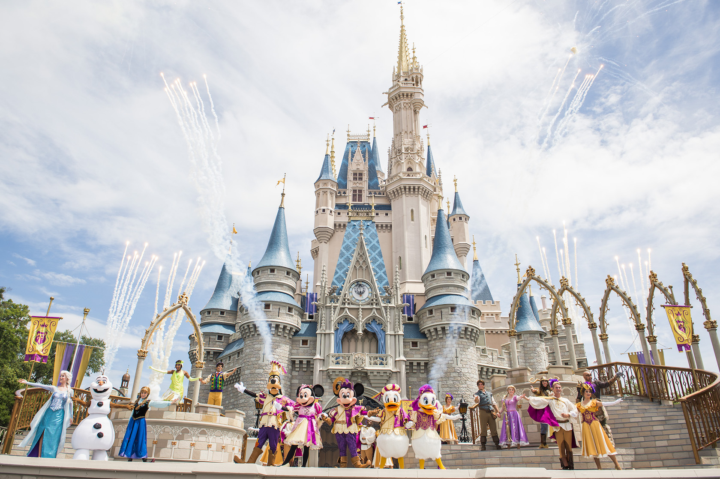
Disney World

Slide 19
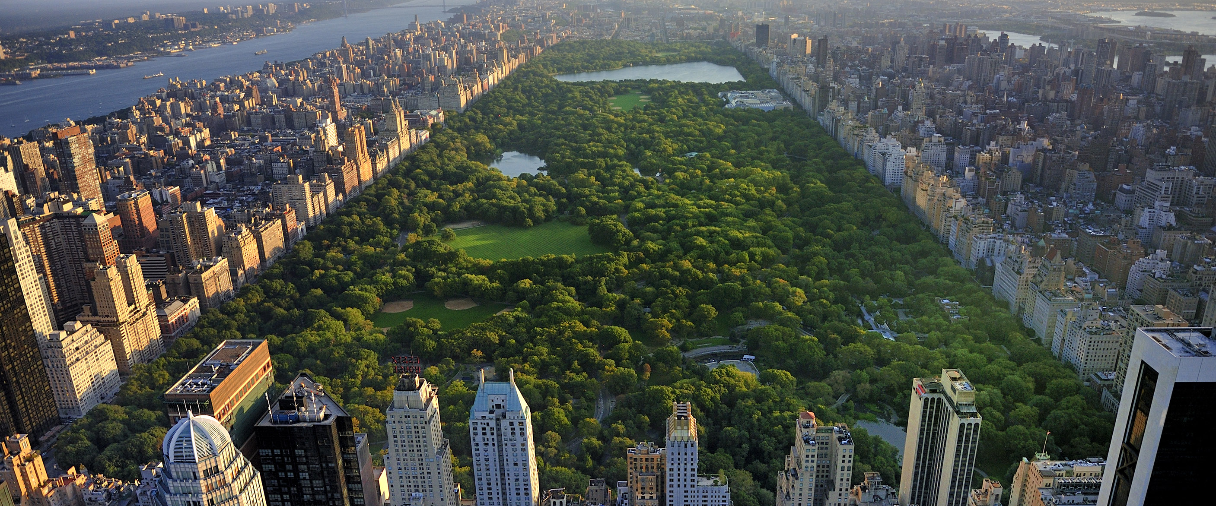
Central Park

Slide 20
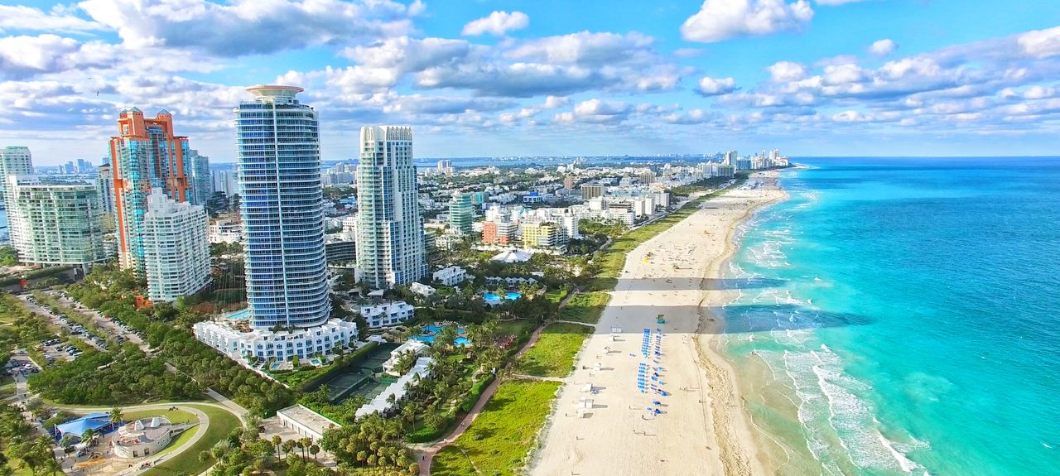
Miami beach

